Slide 1





Automate state
with
AWS State Manager
November 2023
Notes:
Here we’ll look at how we can improve the Start/Stop of our Aurroa clusters with Systems Manager

Slide 2
What is AWS State Manager?
Part of AWS Systems Manager
Automates the process of keeping managed nodes in a defined state
Installing antivirus software on managed nodes
Joining managed nodes to an Active Directory domain
Starting of Stopping RDS instances
and more…
Multiple targeting options
Flexible scheduling options
Available at no additional cost
Notes:
AWS State Manager is a capability of Systems Manager that automates the process of keeping managed nodes or AWS resources in a defined state
By leveraging SSM Documents, State Manager can automate processes like
Bootstrapping nodes with specific start-up software
Joining nodes to an Active Directory domain
Starting or Stopping RDS instances
We can target managed nodes, including on-prem instances, as well other AWS resources
State changes can be applied immediately or on a set frequency
Best of all, AWS State Manager is available at no additional cost

Slide 3
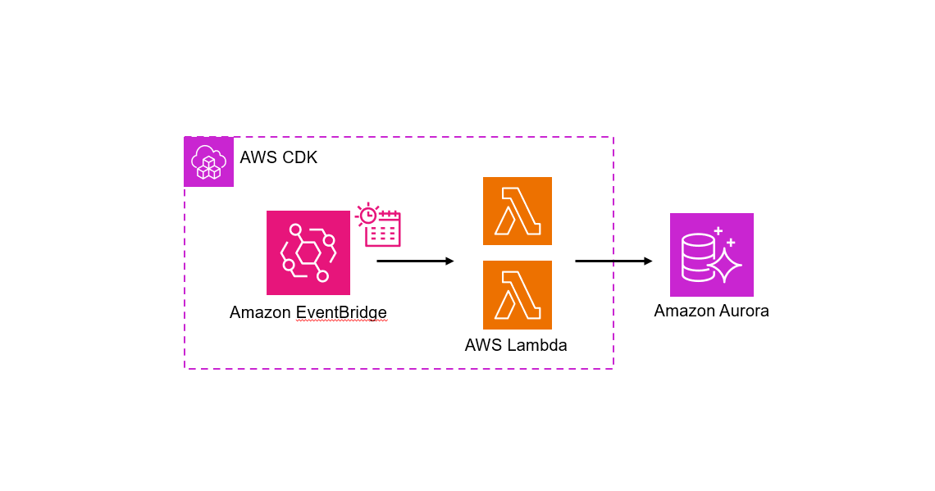
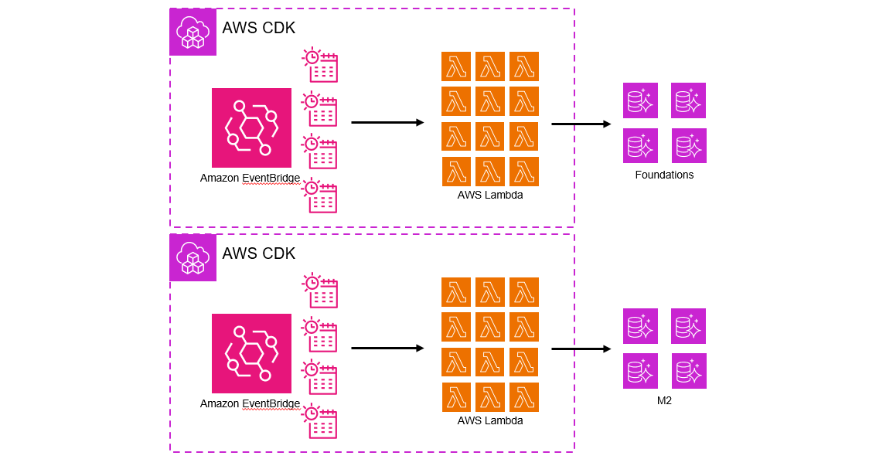

Existing Solution
56 Lambda Functions/28 EventBridge Rules
Reserved Concurrency Limit
Lambda execution costs
Per-app configuration
Automate the Start/Stop of Aurora Clusters
Notes:
> The existing solution consists of an EventBridge scheduler rule and multiple Start/Stop Lambda functions with custom code
> When we add additional applications, we duplicate this infrastructure
> With a larger team, this quickly grows
> Having over 56 Lambda functions results in an ineffective management of resources
Each scheduled invocation eats away at our Regional Lambda Reserved Concurrency limit
We have unnecessary costs for Lambda compute
There is IaC and custom code embedded within our application, all of which has to be duplicated when we add another cluster

Slide 4








Architecture
AWS Systems Manager
AWS State Manager
Amazon EventBridge
Amazon SNS
Association
StartStopAuroraClusterWithTags
Amazon Aurora
Notes:
> The solution with AWS State Manager requires creation of an Association
> The Association executes a modified version of the AWS-managed SSM Automation Document, AWS-StartStopAuroraCluster, which I have modified by adding support to control it using Tags
> Using a cron expression to trigger the automation process, we can have the Association execute the SSM Automation Document to Start and Stop our Aurora clusters
> The built-in integration to Amazon EventBridge also means we can > subscribe an email subscription to an SNS Topic to receive notifications on this state change
With this design we can leverage the built-in capabilities of AWS State Manager to automate a start/stop process to manage our Aurora cluster resources effectively without any custom development

Slide 5

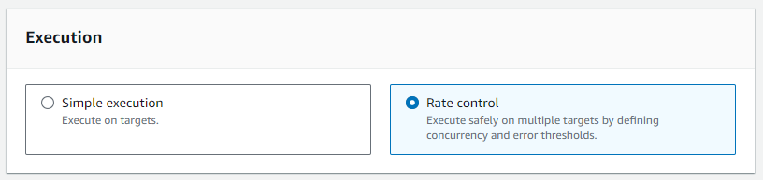
Caveats
Limited cron expressions supported
https://docs.aws.amazon.com/systems-manager/latest/userguide/reference-cron-and-rate-expressions.html#reference-cron-and-rate-expressions-association
AWS::SSM::Association only supports Rate Control executions
Notes:
Of course, this wouldn’t be an AWS service without some things that don’t work properly
Firstly, support for complex cron expressions is limited, such as multi day windows
This appears to be only for AWS State Manager associations so may change in the future
The CloudFormation API also only supports Rate Control executions right now
This means after the AWS State Manager association is created, I have to go change the execution type from Rate Control to Simple within the console
Fortunately, this is only a one-time change and should be a non-issue once the feature is added

Slide 6



Demo Time
Start and Stop

Slide 7
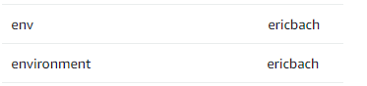
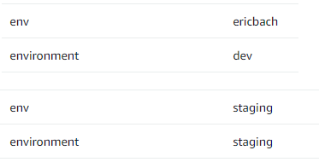
What now?
Review and approve the following PR #1097
Removes existing IaC code using Lambda function to Start/Stop clusters
Sets environment tag to “dev” for all non-staging/prod/security scan environments
Deploy AWS State Manager association
Re-deploy developer F1/M2 environments (without hotswap)
Work with CloudOps to clean up initial SSM Automation scripts
Notes:
To get this released in our environments, I have PR for you to review
Removes existing Lambda function implementation
Changes the tags for the environment key for all developer environments to dev, the env key still remains as the developer GitHub username
Then we need to deploy the AWS State Manager association
Once each developer re-deploys their F1/M2 developer environments without hotswap it will be all setup
Work with CloudOps to clean up their initial implementation with SSM Automation scripts

Slide 8


Thank you!
Feedback
Questions

Slide 9








Getting Started
Managed nodes and AWS resources
AWS-InstallApplication
AWS-ApplyPatchBaseline
Association
AWS State Manager
AWS-CreatedDynamoDbBackup
Notes:
To get started with AWS State Manager, determine the state you want to apply to your AWS resources
> This will dictate which SSM Document to use for the association
> We can use either AWS-managed or customer created SSM Documents
> Now, create a State Manager association which specifies the configuration to be assigned to the managed nodes or AWS resources
> This includes the parameter for the SSM Document,
> The targets, which can be tags, instance IDs, AWS Resource Groups, or all managed nodes in a Region and Account,
> As well as the schedule describing when or how often to apply the state

